Slide 1

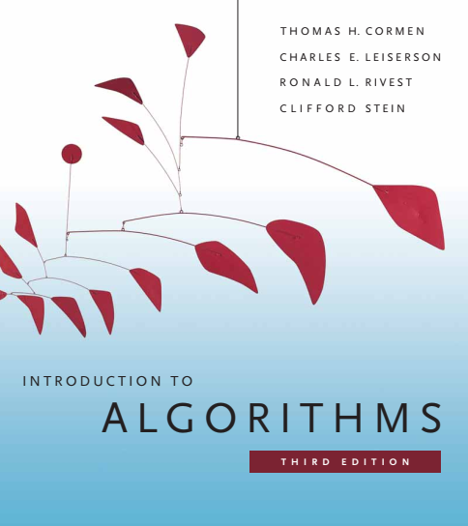
Design and Analysis of Algorithms
Dr. Sajid Iqbal
sajidiqbal.pk@gmail.com
Reference Book
Introduction to Algorithms 3rd Edition By Thomas H. Cormen et. al.
https://mitpress.mit.edu/books/introduction-algorithms-third-edition
COMEDXD

Slide 2
Hash Tables
Hashing and direct address tables

Slide 3

Dictionary data structure
Dictionary Data Structure: It is a general purpose data structure for storing a group of objects
This is (key, value) pair based data structure
Each key has an associated value item
Instead of numeric indexing, key can be used to access specific values
The keys in a dictionary must be simple types (such as integers or strings) while the values can be of any type
Example
$marks=\left\{‘sajid’,:95, ‘nasir’:50,’wajid’:78,’summar’:70\right\}$
$marks[^{′}sajid^{′}]$ will return the value 95
The concept of a key-value store is widely used in various computing systems. Few examples are
Caches memories
high-performance databases
a compiler that translates a programming language maintains a symbol table

Slide 4

Dictionary Data Structure
Main operations of dictionaries
Storing a value $Dict[^{′}key^{′}]=value$
Accessing a value $value=Dict[^{′}key^{′}]$
Updating a value $Dict[^{′}key^{′}]=new_value$
Searching a value
Removing a value
A dictionary is also called a hash, a map, a hashmap
Dictionaries are often implemented as hash tables.
Hashing can perform extremely well for its operations

Slide 5
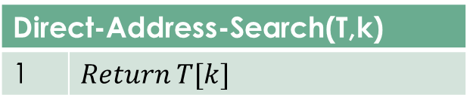

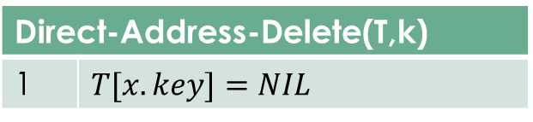
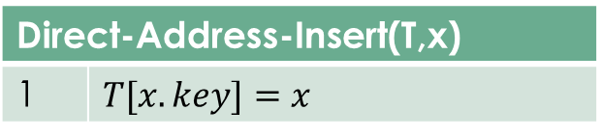
Direct Address Tables (DAT)
Direct addressing is a simple technique that works well when the universe U of keys is reasonably small $U=\left\{1,2,3,…., m−1\right\}$
To represent this dynamic set, an array can be used known as DAT
$DAT=T[0,1,2,…,m−1]$
slot k represents the element in the set with key k.
Each of the Basic operations takes $O(1)$ time and is given as
Direct-Address-Search(T,k)
1 | $$Return T[k]$$
Direct-Address-Insert(T,x)
1 | $$T[x.key]=x$$
Direct-Address-Delete(T,k)
1 | $$T[x.key]=NIL$$

Slide 6
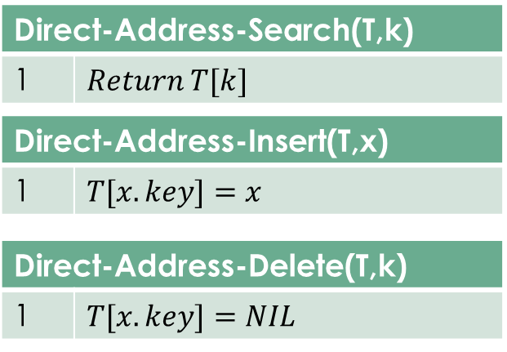









Direct Address Tables (DAT)
T | Add
 | 0
 | 1
 | 2
 | 3
 | 4
 | 5
 | 6
 | 7
 | 8
/ | 9
$$k_{0}$$
0
$$k_{1}$$
$$k_{2}$$
$$k_{3}$$
$$k_{4}$$
$$k_{5}$$
$$k_{6}$$
$$k_{7}$$
$$k_{8}$$
M-1

Slide 7

Direct Address Table
Merits
Fastest operation time $θ\left(1\right)$
Limitations
Prior knowledge of maximum key value to define the size of DAT
Practically useful only if the maximum value is very small
For larger maximum value, wastage of memory space
Issue with multiple similar keys

Slide 8



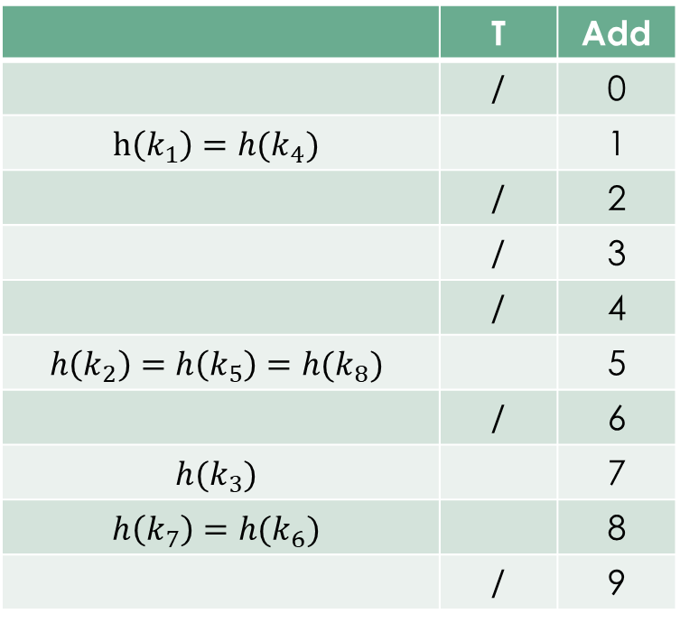





Hashing Function
A function that is used to distribute keys among all slots of DAT
Hash function
 | T | Add
 | / | 0
$$h\left(k_{1}\right)=h(k_{4})$$ |  | 1
 | / | 2
 | / | 3
 | / | 4
$$h\left(k_{2}\right)=h\left(k_{5}\right)=h(k_{8})$$ |  | 5
 | / | 6
$$h(k_{3})$$ |  | 7
$$h\left(k_{7}\right)=h(k_{6})$$ |  | 8
 | / | 9
0
$$k_{1}$$
$$k_{4}$$
$$k_{2}$$
$$k_{5}$$
$$k_{3}$$
$$k_{8}$$
$$k_{7}$$
$$k_{6}$$
M-1

Slide 9
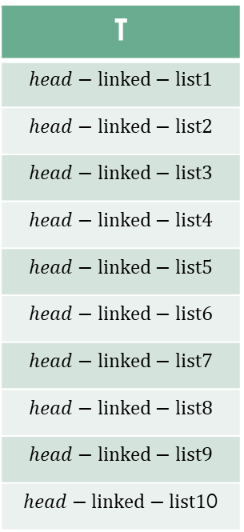
Handling Collisions in Hash Table
Key Collision: There may be possibility that two key map to same array location
Solution of collision:
Choose a suitable hash function h
Use some technique to manage such collisions
Chaining for collision resolution
Each slot in an array keeps the address of the head of linked list
All items colliding in one slot are placed in same list
T
$$head−linked−list1$$
$$head−linked−list2$$
$$head−linked−list3$$
$$head−linked−list4$$
$$head−linked−list5$$
$$head−linked−list6$$
$$head−linked−list7$$
$$head−linked−list8$$
$$head−linked−list9$$
$head−linked−list1$0

Slide 10
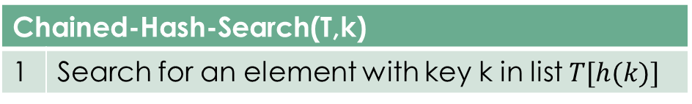
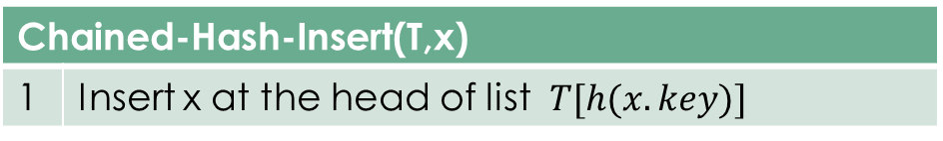

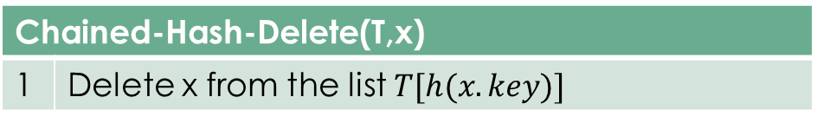
Dictionary Operations and Collisions
The dictionary operations on a hash table T are easy to implement when collisions are resolved by chaining:
Worst case running time for insertion is $O(1)$
Chained-Hash-Insert(T,x)
1 | Insert x at the head of list $T[h(x.key)]$
Chained-Hash-Search(T,k)
1 | Search for an element with key k in list $T[h(k)]$
Chained-Hash-Delete(T,x)
1 | Delete x from the list $T[h(x.key)]$

Slide 11








T
/
/
/
/
/
/
$$k_{1}$$
/ | K1
 | k4 | /
$$k_{4}$$
$$k_{2}$$
$$k_{5}$$
$$k_{3}$$
/ | k2
 | k5
 | k8 | /
$$k_{8}$$
$$k_{7}$$
/ | k3 | /
$$k_{6}$$
/ | k6
 | k7 | /

Slide 12

Hashing with Chaining Analysis
Let there is hash table T with m slots that stores n elements
$Load factor → α=\frac{n}{m}$ (average number of elements stored in a chain)
$Load factor$ can be less than, equal to or greater than 1
If bad hash function is used, the worse case could arise where all elements are hashed to one slot creating single long linked list
Worse case for insert is $O(1)$
Worse case for searching is $θ\left(n\right)+time to compute hash function$
Simple uniform hashing
An element n has equal probability to be hashed to any slot
For array slots $j=0,1,2,….,m−1$, if each slot has linked list associated
If $T[j]$ is length of linked list at slot j then
Total of length is $n=n_{0}+n_{1}+n_{2}+…+n_{m−1}$ then
Expected value of $n_{j} =E\left[n_{j}\right]=α=\frac{n}{m}$

Slide 13

Theorem 11.1
Theorem:
A hash table where collisions are resolved by chaining, an unsuccessful search take average case time $θ\left(1+α\right),$under assumption of simple uniform hashing
Proof:
Any key k can be equally stored in any slot of table
Expected time for unsuccessful search of a key k is the expected time to search to the end of the list $T[h(k)]$which has expected length $E\left[n_{h\left(k\right)}\right]=α$
Thus expected number of elements checked for unsuccessful search is $α$
Total time for unsuccessful search including has function computing is
$θ(1+α)$

Slide 14

Theorem 11.2
Theorem:
In a hash table in which collisions are resolved by chaining, a successful search takes average-case time $θ(1+α)$ under the assumption of simple uniform hashing
Proof:
Element to be searched is equally likely any of n
Although book presents the case in different way, we follow a simple one
Expected length of any linked list in hash table is $n_{j} =E\left[n_{j}\right]=α=\frac{n}{m}$
On the average, we search half of the array with load factor $α$ = $\frac{α}{2}$
If there is 1 time for hash function then total search time is $θ\left(1+\frac{α}{2}\right)≅θ(1+α)$

Slide 15

Thanks for watching
Dr. Sajid Iqbal
Assistant Professor
Department of Computer Science
Bahauddin Zakariya University, Multan
sajidiqbal.pk@gmail.com
Slides: https://github.com/sajjo79/Design_and_Analysis_of_Algorithms
YouTube Channel: COMEDXD
Allah Hafiz

